Slide 1
PROJECT ONE
POKEMON STAY

Slide 2
QUESTION SEVEN - CALCULATING PLAYER POWER
7. Calculate player "power".
Define a function that will calculate a player's "power". Player power is defined as the sum of the base statistics all of their pokemon.
Your function will:
Accept the players dictionary, pokedex dictionary, and a player_id as arguments.
For the specified player_id, look up that player's pokemon and their level(s).
Find and aggregate the attack and defense values for each of the player's pokemon from the pokedex dictionary.
Print "[player name]'s power is [player power].", where the player power is the sum of the base statistics for all of their pokemon.
Return the player's power value.
Print out the pokemon power for each of your players.

Slide 3
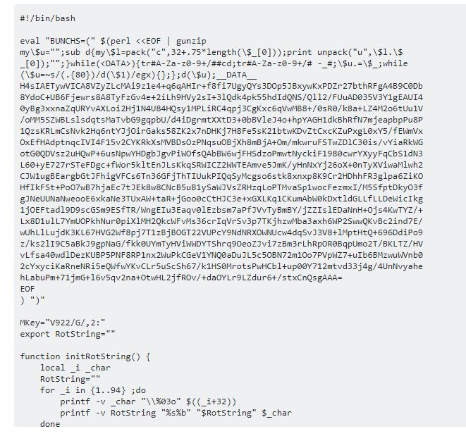
QUESTION SEVEN - CALCULATING PLAYER POWER
This is honestly what I was seeing in my head everytime I looked at this question.

Slide 4

QUESTION SEVEN - CALCULATING PLAYER POWER

Slide 5
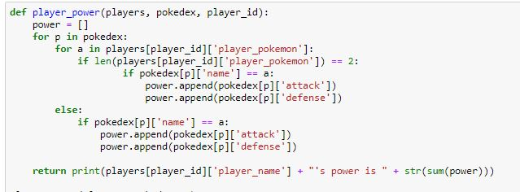
QUESTION SEVEN - CALCULATING PLAYER POWER
I thought I had done it, I was so happy……
UNTIL……..

Slide 6

QUESTION SEVEN - CALCULATING PLAYER POWER

Slide 7
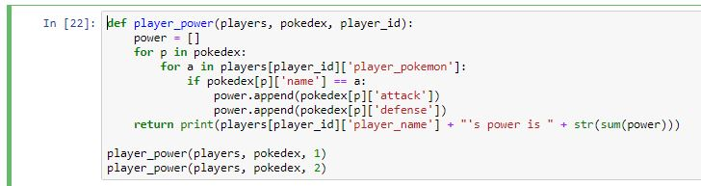
QUESTION SEVEN - CALCULATING PLAYER POWER
If the list of pokemon was sent to the player as a list, then It wouldn’t matter how many pokemon they had.

Slide 8

QUESTION SEVEN - CALCULATING PLAYER POWER

